Slide 1
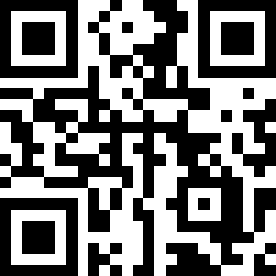
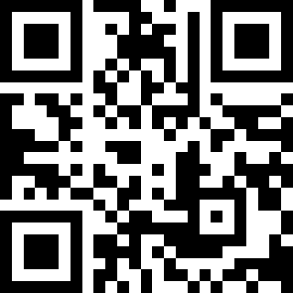
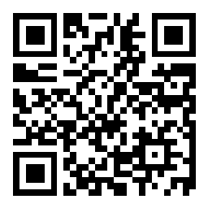
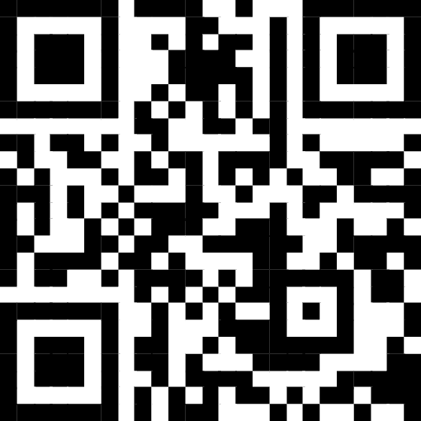
Join us on Slack!
https://tinyurl.com/bdfc69uz
Course Materials
https://tinyurl.com/yvykzwwa
Q and A/Polls
Further Materials
WIFI apsmarch24
Session L02: GDS Business Meeting
6:15 PM–7:15 PM, Tuesday, March 5, 2024 Room: M100I

Slide 2






